Slide 1
People Strategy 2022 to 2025
Marika Stephenson
Executive Director of People Services

Slide 2
Contents
3
7
People Plan, Promise & Vision
About this strategy
8
4
Themes, Intent, Outcome
Our Ambitions
Who are we?
12
5
Actions & Measure of Success
Themes
Purpose, Vision & Values
16
6
Internal & External
Going Back to Basics
Our Challenges
17
What’s Next?
Our Challenges

Slide 3
About this strategy
What does a People Strategy mean?
How can it be meaningful to all of us?
How can it describe simply & effectively what EEAST offers to all of us who work for the Trust?
How do we know what to expect and what is expected of us?
This ‘strategy’ aims to answer those questions. It may not be perfect, it may not provide all the answers, it may not offer all the solutions but it is the start of a conversation.
A conversation that involves all of us at EEAST who want to say:
“This is how we are making EEAST the Trust we all love to work for”
Notes:
In this slide, I think it’s advisable to state that at phase 3, although we mention consultation due to there being a new business model, we have no reason to believe there will be any at risk positions.

Slide 4
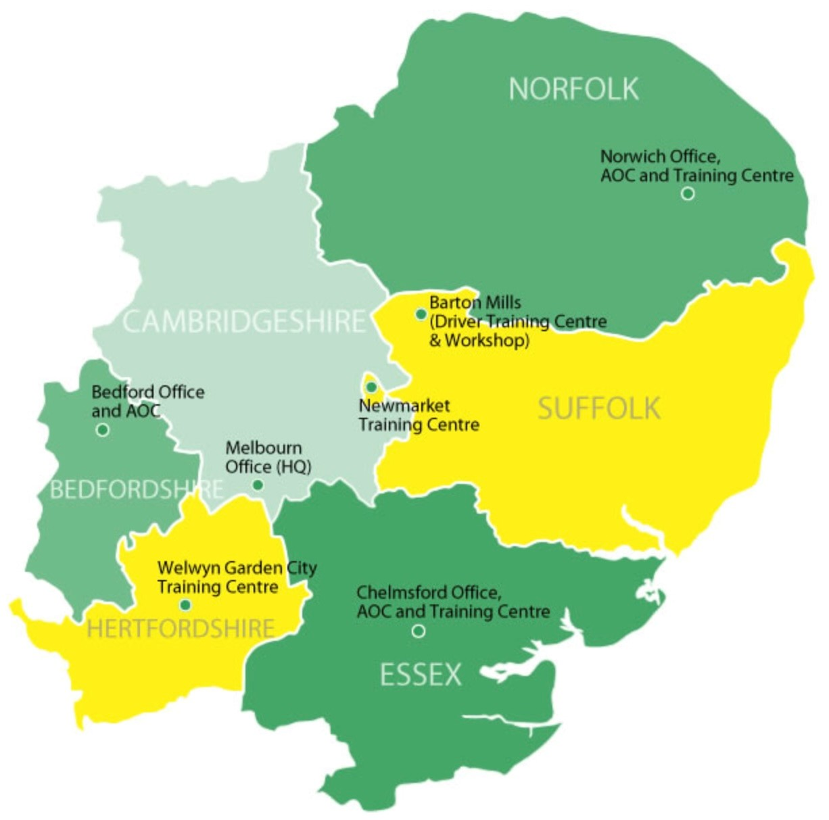
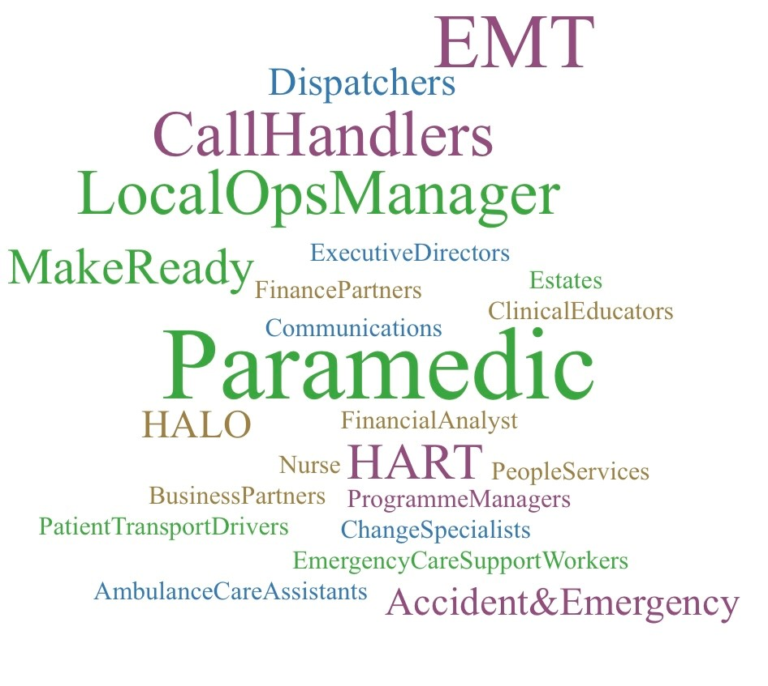
Who are we?
5,000+ Staff
3 Ambulance Operations Centres
387 Front Line Ambulances
178 Rapid response Vehicles
175 non-emergency ambulances
46 HART / major incident / resilience vehicles
120+ sites
People Services
Finance
Technology
Cleaning Services
Serving
6.2 million people
7,500 square miles
15 CCG’s
17 Acute Trusts
Recruitment
Procurement
Education
Notes:
In this slide, I think it’s advisable to state that at phase 3, although we mention consultation due to there being a new business model, we have no reason to believe there will be any at risk positions.

Slide 5
Our Purpose, Vision & Values
Our Purpose
Providing urgent & emergency healthcare for our communities
Our Vision
Outstanding care, exceptional people, every hour of every day
#WeAreEEAST
Our Values
Care
We value warmth, empathy and compassion in all our relationships
Teamwork
Together as one, we work with pride and commitment to achieve our vision
Quality
We strive to consistently achieve high standards through continuous improvement
Respect
We value individuals, including our patients, our staff and our partners in every interaction
Honesty
We value a culture that has trust, integrity and transparency at the centre of everything we do.
Notes:
In this slide, I think it’s advisable to state that at phase 3, although we mention consultation due to there being a new business model, we have no reason to believe there will be any at risk positions.

Slide 6
Our Challenges
Resourcing
Development
Health & Wellbeing
Staffing, mix and volume
Retention of valued staff
Too much overtime
Not enough time to do training
My Job
Lack ability to make Improvements
Don’t feel trusted to do my job
Exhausted Staff
Working out of area / Unable to take breaks
Equality Diversity & inclusion
Lack of Dignity at Work
Don’t always work as one Team
Not safe from bullying & harassment
Mental & Physical illness
Not psychologically safe
Lacking a Voice
Lack a defined career path
Use of capable mentor
Inability to take opportunities
Concerns are not heard
Lack regular, meaningful appraisals
Don’t feel supported
System
Hospital Beds
Geographical
Global
Community Beds
Mental Health Provision
Area Coverage
Demographic distribution
Provision of wider support services
COVID 19
Political
Financial
Regulated activities: EHRC / CQC
Notes:
You may wish to say that this is only a snapshot (not exhaustive) and that more detail will come out with Staff Survey publication

Slide 7
NHS People Plan, Promise & Vision

Slide 8
Our Ambition
Alignment to ‘NHS People Promise & The future of NHS 2030 vision | Themes | Intent | Outcomes
Prioritising the health & wellbeing of all our People. We are safe & healthy. We work flexibly. | Looking After Our People; Health & Wellbeing | We take a positive and proactive approach in supporting the health, safety & wellbeing of our NHS people, ensuring that work has a positive impact. We address health inequalities at work and in our communities. | Work / Life Balance Realistic Time Pressures Meal breaks & reliable shift patterns are adhered to – finish shift at home station as rota’d. Access to mental & physical health restoration Safe sharing environment Flexible Working opportunities
Creating a great employee experience. We are recognised & rewarded. We are a Team. | Looking After our People: Employee Experience | We understand the diverse needs, expectations & experience of our NHS people & use that insight to tailor our people services. We attract & retain people in EEAST, creating a positive impact on our communities. | Enough qualified staff in the right place at the right time Retain valued staff Overtime is an exception & not built into the shift pattern Contingent staff available as required Respectful to self & others Work as one Team
Notes:
This is quite indepth so do you think it is worth including or it might be too much? Generate more questions than required.

Slide 9
Our Ambition
Alignment to ‘NHS People Promise & The future of NHS 2030 vision | Themes | Intent | Outcomes
Ensuring inclusion & belonging for all. We are compassionate & inclusive. | Belonging in the NHS: Equality, Diversity & Inclusion | We use our expertise & influence to create an inclusive culture, which values and celebrates our diversity. We listen to each other & take action to ensure there is equity for everyone. | I am understood I feel represented I am seen & respected for who I am I have a Voice We reflect the community we serve I am safe from bullying & harassment We make reasonable adjustments
Supporting, developing & harnessing the talents of all our people. We are always learning. | Looking After our People: Developing our People | We support everyone working in EEAST to be their very best and reach their full potential. We help all our people to fulfil their ambition and potential. We build strong leadership & management capability at all levels. | Confident to do job or ask for help when needed Have a defined career path Use of capable mentor Can access formal or informal coaching Have regular, meaningful appraisals Capacity to complete Stat / Man in work hours Further education & development opportunities are accessible.
Notes:
This is quite indepth so do you think it is worth including or it might be too much? Generate more questions than required.

Slide 10
Our Ambition
Alignment to ‘NHS People Promise & The future of NHS 2030 vision | Themes | Intent | Outcomes
Leading Improvement Change & innovation We each have a voice that counts | Growing for the Future: Building together through innovation. | We are productive, efficient and responsive. Our operating model delivers transformation & embeds innovation across organisations & systems. We embrace new ideas and grow together. | Ability to make Improvements Involved in Changes that impact work Opportunities to show initiative Know my responsibilities Trusted to do my job
Embedding digitally enabled solutions. | Growing for the Future: Making life better via Digital solutions. | We make best use of technology & digital solutions to deliver great services, developing our digital capability to equip ourselves for the future. | Technology enabled solutions driving efficiency and making life easier.
Notes:
This is quite indepth so do you think it is worth including or it might be too much? Generate more questions than required.

Slide 11
Our Ambition
Alignment to ‘NHS People Promise & The future of NHS 2030 vision | Themes | Intent | Outcomes
Enabling new ways of working and planning for the future. | New ways of working and delivering care. | We enable the people of EEAST to work differently, to support new models of care. We anticipate the needs of the health and care system & create a sustainable workforce which meets the needs of our patients now & in the future. | Spans of Control Right Balance of Leaders to Employees Strategic Workforce Plan - knowing our resource requirements for next 5 years.
Supporting and developing the people profession | Growing for the Future Transforming the People Profession. Build the capabilities and expertise of people professionals that support service transformation, leadership development and cultural change within EEAST. | We support everyone working in the people profession to be their very best and reach their full potential. Together we provide outstanding people practises. | Value added Strategic partners to the Directorates Provide swift resolution to people issues and concerns. Centres of Expertise in people related matters. Technology enabled solutions increasing speed & provision of people services. Support new models of care, leadership & positive cultural initiatives.
Notes:
This is quite indepth so do you think it is worth including or it might be too much? Generate more questions than required.

Slide 12
Themes 2022 - 2025
Employee Experience
Health & Wellbeing
Employee Experience
Year 1
Agreeing what well being means to EAST
Mental Health & Well Being Ambassador Program
New Menopause Guidance adopted
Trust wide availability of ‘Headspace’ app.
Build a pan East well being network
Define well being metrics/KPI’s that will make a difference
Year 1
Introduce pulse surveys
Implementing a retention strategy
Resolution of longstanding T&Cs cases
Producing an effective Workplan
Improving the disability support offered to staff
Year 2
Effective Crisis Management / OH / EAP services
Increase Mental Health & MSK support locally
TRIM / Mental Health First – Aiders Practitioners
Mediation & ER Triage reduces resolution time frame
Year 2
Continuation of pulse surveys
Dedicated HRBP resources to assist change in hotspot areas
Disability Confident employer status
Training & development for leaders
Year 3
Workforce planning strategy secures right people in right place at right time to eliminate travel burden.
ICS initiatives reduce handover delays
Flexible Working Options embedded
Year 3
Continuation of pulse surveys
Further reduction in staff turnover rates
We will know that we have it right when:
We will know that we have it right when:
Sickness absence & Overtime reduced.
Staff Survey H&W indicators in upper quartile of ambulance trusts.
Thriving employees.
Year 3
Pulse Survey reports high satisfaction.
Retention has increased.
Staff Survey indicators are in upper quartile of ambulance trusts.

Slide 13
Themes 2022 - 2025
Equality, Diversity & inclusion
Developing our People
Developing our People
Year 1
Launch of Multifaith & All Women’s EEAST staff networks
Improved Reasonable Adjustment / Redeployment process
Values & Cultural awareness training for all staff
ED&I recruitment resource appointed
Cultural Ambassadors
Year 1
Leadership development package.
Continuation of Managers Passport Training & specialist workshops.
Improvement in secondment & development opportunity processes.
Introduce reciprocal mentoring.
Year 2
Community recruitment initiatives working with NHS partners.
Team building / relationship management sessions.
All directorates have diversity improvement plans accountable to Executive lead.
Year 2
Introduction of apprenticeships for Support Services.
Delivery of Leadership Programme (Year 1).
Begin ‘talent planning’ processes.
In-house Coaching Programme design.
Year 3
Enhanced ‘attraction’ initiatives with schools & colleges.
Colleagues with protected characteristics have access to dedicated support networks.
Year 3
Delivery of Leadership Programme (Year 2).
Continued Leadership Engagement Events.
Holistic, grade agnostic, development capability.
We will know that we have it right when:
We will know that we have it right when:
BME staff are proportionately represented at all levels of the Trust.
Our EDI score on the staff survey is in the upper quartile.
All safe feel psychologically safe at work.
No ER cases related to reasonable adjustments.
Staff Survey indicators are in upper quartile of ambulance trusts.
Retention is significantly improved.
EEAST is known as a ‘Learning’ organisation.

Slide 14
Themes 2022 - 2025
Building through Innovation
Make life better via digital solutions
Year 1
People Services Transformation leading to Strategic Business Partnering, Shared Services & Centres of Expertise.
Improvements and initiatives delivered in line with EHRC / CQC requirements.
Culture & Strategy Directorate established.
Year 1
Scoping of ESR enhancements
Electronic files
Triage of People Services
Year 2
System review of 999 / 111 capabilities
Development of remote diagnostician role.
Year 2
ESR Self Service
ESR Supervisor Service
Triage Telephony in People Services
Year 3
Increased co-operation between clinical communities of practise.
Medical / Clinical Triage
Greater emphasis on ‘hear & treat’, ‘see & treat’.
Year 3
Digitally enabled decision making
We will know that we have it right when:
We will know that we have it right when:
The ability to make improvement, show initiative and become involved in change which positively impacts our work, is a recognised attraction to working at EEAST.
We get speedy resolution to queries.
Notes:
Need to fill out digital section

Slide 15
Themes 2022 - 2025
New ways of working & delivering
Make life better via digital solutions
Transforming the People Profession
Year 1
Strategic Workforce plan is published
Spans of Control programme commences
Recruitment department fully resourced
Strategic Workforce Plan actions review
Year 1
Design Target Operating Model for People Services
Resource Directorate establishing Strategic Business Partnering / Transformation, Shared Services and Centres of Expertise for Employee Relations/Resourcing/People Intelligence/Health & Wellbeing.
Scope Technical solutions to support easy access to queries.
Establish Metrics to measure success.
Year 2
Proactive recruitment programs in place.
Spans of Control work delivered creating right balance of leader to employee.
Directorates have ‘devolution’ programs enabling delegation of decision making to the sectors with centres providing frameworks & high quality support.
Preceptorship program relaunch
Year 2
Stabilise Service Delivery Model.
Engage with Community partners to deliver inclusive and skilled resources to EEAST.
Refine and improve service catalogue.
Embed technical improvement within processes and systems.
Year 3
Implementation of Strategic Workforce Plan ‘Six Families’ actions.
Year 3
Continual Improvement of processes.
Ensure all People Services are proficient in design & systems thinking achieving national benchmark standards.
We will know that we have it right when:
We will know that we have it right when:
EEAST is regarded as an employer of choice.
Use of contingent workforce and overtime for scheduled work is eliminated.
People Services is regarded as a value added, enabling partner for all the Directorate of EEAST.

Slide 16
Going Back to Basics
Building Foundations Fit For Purpose
Creating our Fit For the Future
Reminding ourselves “Why” we come to work each day
Owning our purpose and values
Treating others with the respect we would like to receive
Behaving in the way we wish to read about ourselves
Removing Bureaucracy from our world
Using Technology to make our workload more effective and less cumbersome
Growing in our own confidence to deal with issues
Creating efficient and realistic ‘Spans of Control’
Effectively redeploying resources via workforce planning & working with system partners
Collaborating with Trust, Respect. Communicating with Purpose aligned with our Values
Always Learning, Always Growing, Always Curious

Slide 17
Next Steps?
Collate Feedback from Leadership meeting on March 23rd 2022.
Present draft People Strategy to ELT by end of March.
Establish Focus Groups throughout EEast to test the assumptions: April to June 2022.
Publish People Strategy July 2022.
Establish Delivery teams responsible for owning and driving the initiatives.
Executive Sponsors allocated per Delivery team.
Quarterly check in with the Executive team on progress.
Notes:
This is quite indepth so do you think it is worth including or it might be too much? Generate more questions than required.

